Slide 1
Numpy
NumPy is a library for the Python programming language, adding support for large, multi-dimensional arrays and matrices, along with a large collection of high-level mathematical functions to operate on these arrays.
Advantages:
Efficient and fast
In-memory
Contiguous.
Homogeneous type
Numpy is suited to many application.
Image processing .
Signal processing
Linear algebra
And many more

Slide 2
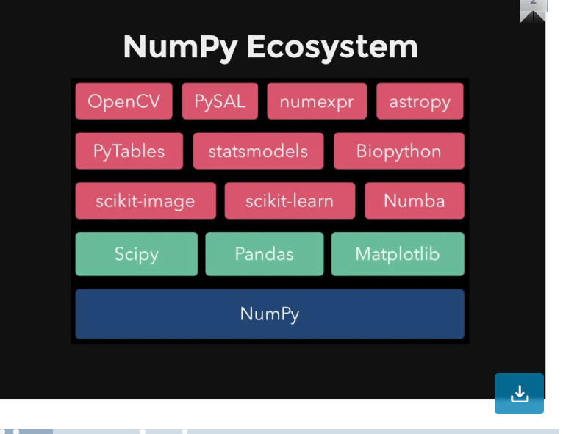

Slide 3
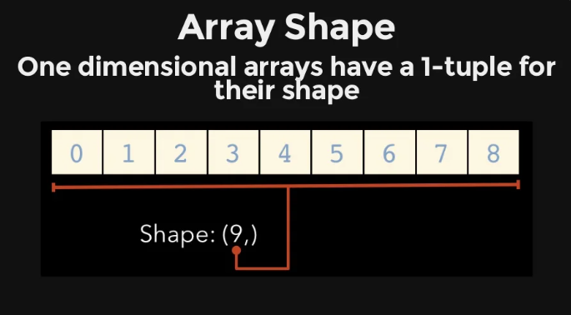
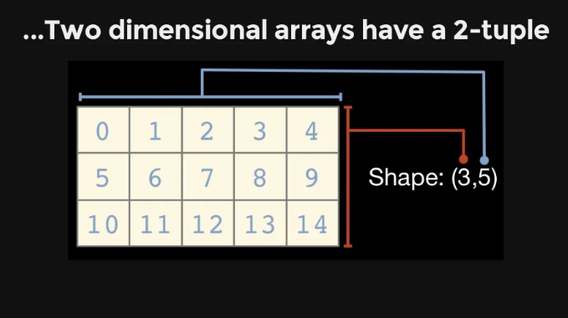
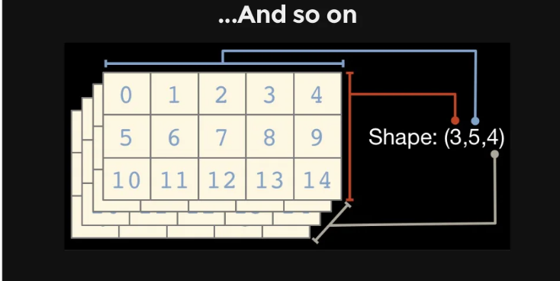

Slide 4
Data Types
Data type | Description
bool_ | Boolean (True or False) stored as a byte
intc | Identical to C int (normally int32 or int64)
int8 | Byte (-128 to 127
int16 | Integer (-32768 to 32767)
int32 | Integer (-2147483648 to 2147483647)
int64 | Integer (-9223372036854775808 to 9223372036854775807)
Uint8, uint16, uint32 | Unsigned integer
Float16, float32, float64 | Half, Single, Double precision float:
complex_, complex64, complex128

